Slide 1
COS & TAB
Notes:
© 2006 Capgemini - All rights reserved
0

Slide 2
Objective
At the end of this session, participants will:
Know features of COMPOSITE and TABBED screens
Be able to create Composite screens
Be able to create TABBED Screens

Slide 3
COMPOSITE SCREEN
Collection of screens in T24 placed in one browser window but different frames
A screen within composite screen can contain
T24 Menus
TABBED Screen
URL
Utility routines

Slide 4
CONTENT TYPE
EB.COMPOSITE.SCREEN is used to build composite screens
The CONTENT.TYPE field can contain the below properties,
OPEN.FRAME: Create a frame set. Tells you are splitting this frame into further frames
CLOSE.FRAME: Closes the frameset
ENQ: This item is an Enquiry
TXN: This item is a contract screen
UTILITY: This allows you to call a browser routine OS.NEW.USER
TAB :This item is a tabbed screen

Slide 5
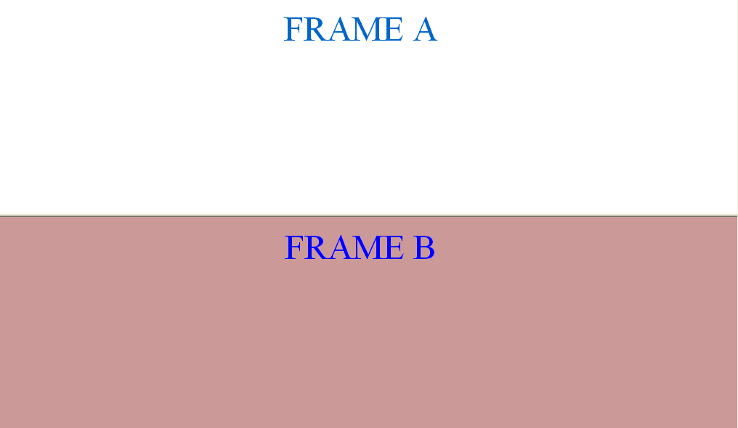
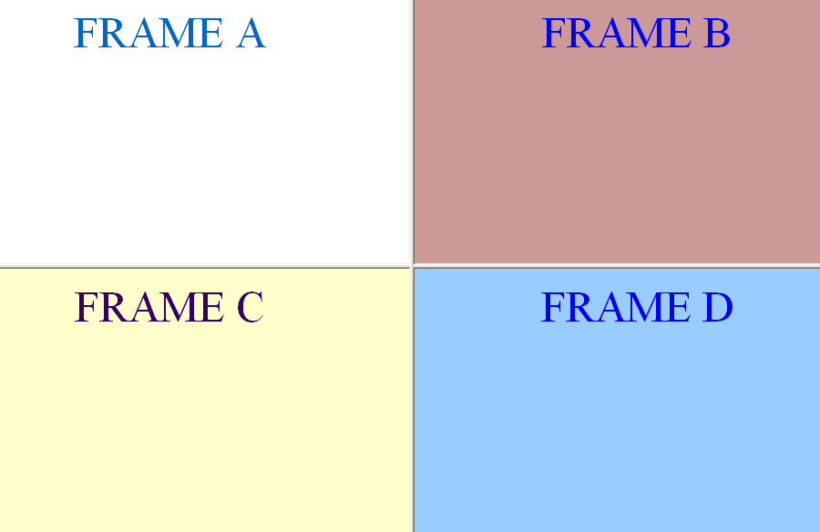
Frames in Composite Screens
Open Frameset
- 50%
1
- 50%
Close Frameset
2
Notes:
Composite screens divides your browser window into different frames. To make your understanding better, you will be introduced to the concept of frames in HTML.
Frames in HTML document can cause a web page to be divided into multiple, scrollable regions. In html the frameset tag can be used to define each frame region. The screen shown here is divided horizontally into two equal regions. This is a row wise split-up. The open frameset and close frameset options are used to define a frame.
The second screen is divided into four different frames. The top frame is further divided into two columns. Each column occupies 50% of the top frame. The bottom frame is also divided into two frames , each frame occupies 50% of the bottom frame.
Lets now try to develop similar composite screens in T24.

Slide 6
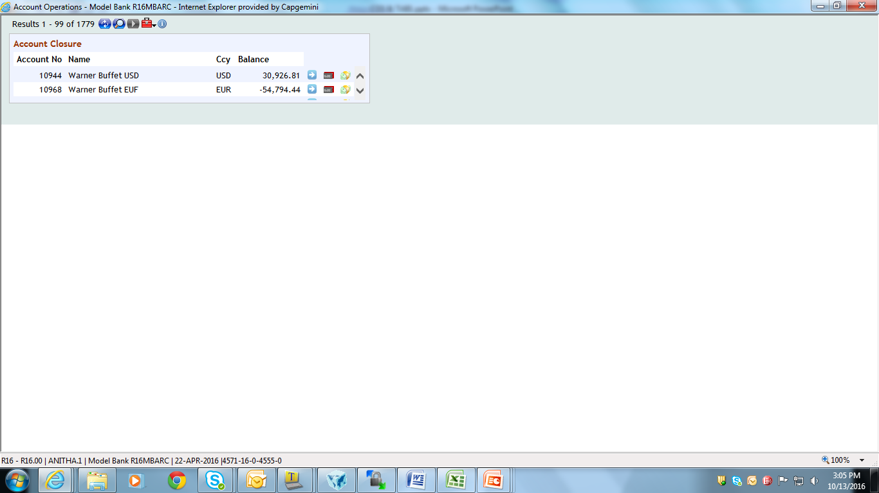
Design a simple composite screen
First half comprises of an enquiry – ACCOUNT.CLOSURE
Second half is left blank
Notes:
Design a composite screen in T24. The browser window should be divided horizontally. The composite screen should be divided in a row-wise manner. First half of the browser window is used to launch the enquiry ACCOUNT.CLOSURE.
The second half is left blank

Slide 7
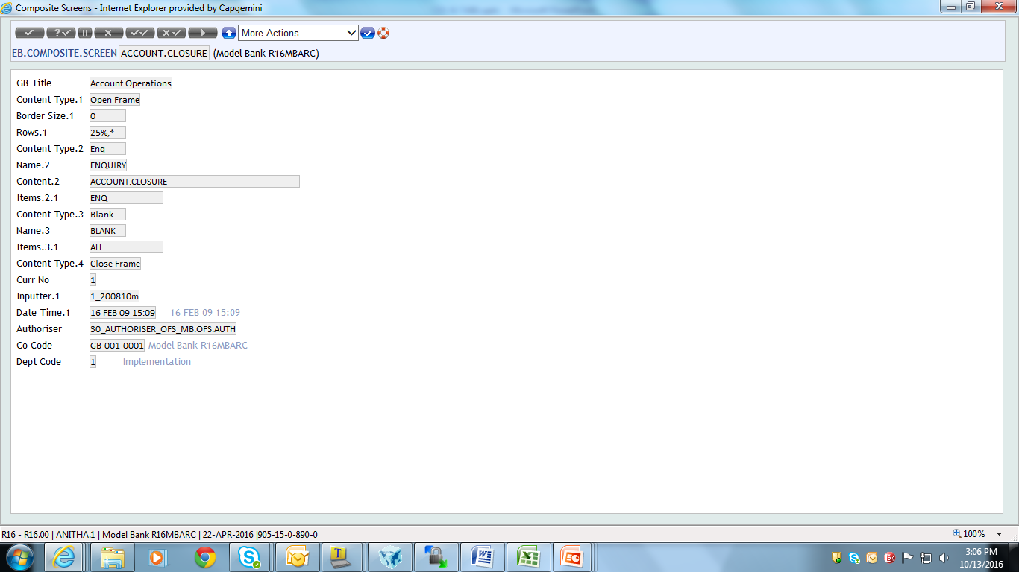
The Composite Screen
Notes:
The application used to create composite screen is EB.COMPOSITE.SCREEN . You may also use the Screen Designer to design the composite screens. The ID of your composite screen can be any alpha-numeric text. Lets look into the fields now.
TITLE – Here you specify the title for the composite screen. The text specified here will be displayed as the description text of your composite screen.
You know that a composite screen is divided into frames. Now where do you specify these framesets?
CONTENT.TYPE – Here you specify the content of a frame. This field has various options in it, one among the options is OPEN.FRAME. By choosing the OPEN.FRAME option you tell the system to open a frameset.
ROWS – Is the frameset divided into rows or columns? If it is a row-wise separation then specify the split-up for each row. Here it is specified as 25%,* which implies that the entire window is divided into two frames. The top frame occupies 25% of the entire browser window and bottom frame occupies the remaining 75%
COLS – The column wise split-up can be specified here in the field COLS
Now the top frame is to launch an enquiry. Therefore in the next multi-value field of CONTENT.TYPE choose the option as ENQ.
CONTENT – Here you specify the content of the frame. Specify the enquiry name here

Slide 8
The Composite Screen
Notes:
Next you need to define the contents of the bottom frame.
CONTENT.TYPE –By choosing the BLANK option you tell the system to display a blank space here. Why is the bottom frame left blank?
ITEMS – In the blank space you can tell the system to launch enquiries, versions or it may take all unassigned requests. The field ITEMS is used to define what requests should be sent to this blank frame. The request is assigned to a window by running through each item until a valid match is found for the request. When you choose the ALL option here you tell the system to launch all unassigned requests in this frame.
Now you will close the frame relevant to the open frame CONTENT.TYPE 1 (Multivalue 1).

Slide 9
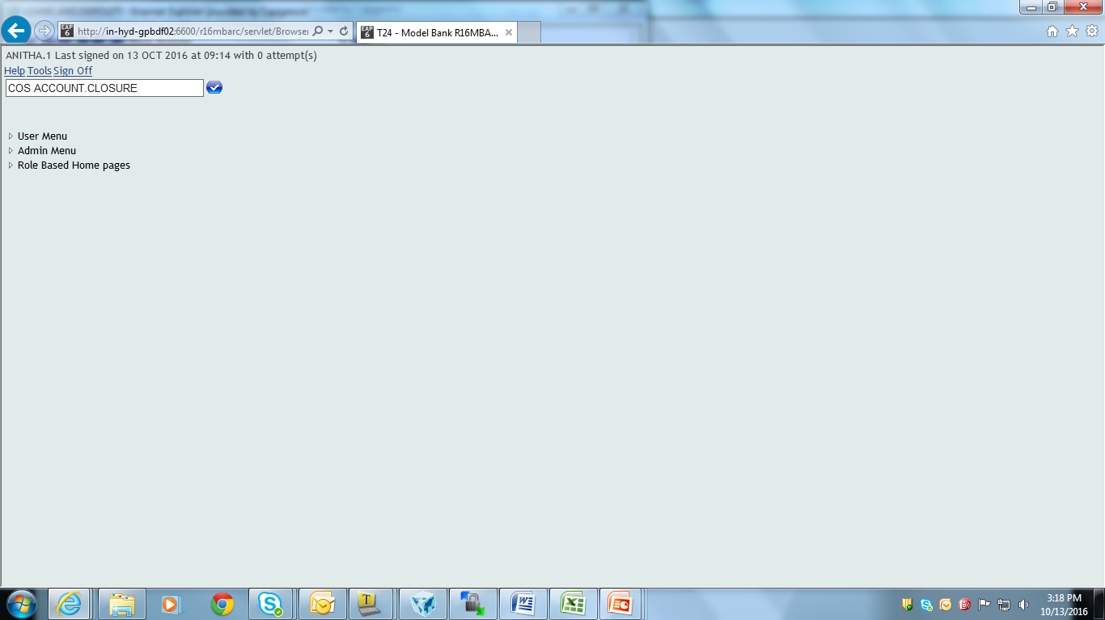
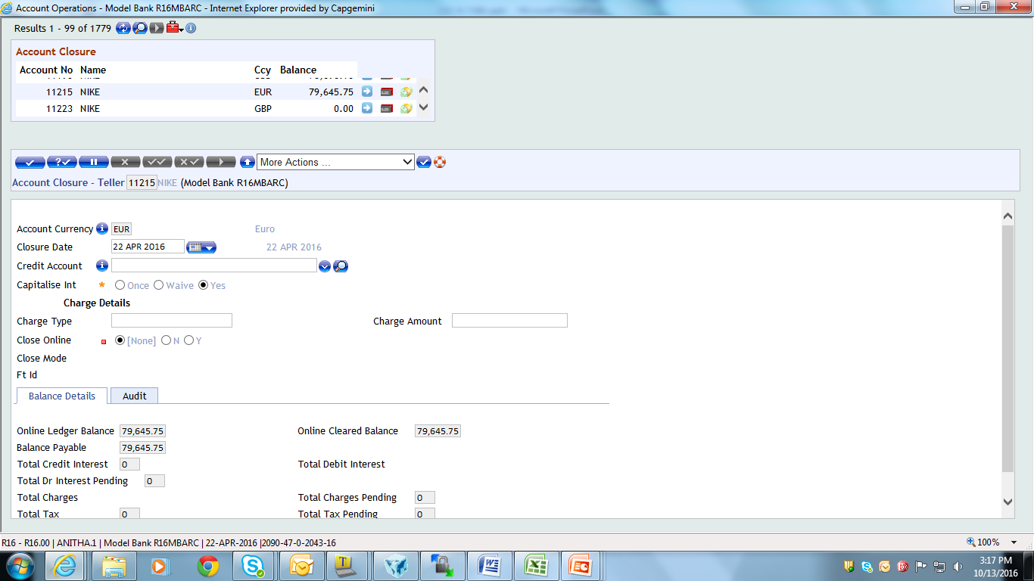
Launch the Composite Screen
Notes:
1.Launch the composite screen by using the COS command. You will specify as COS followed by the composite screen id.
2. You could see the launched composite screen here. Now when you click on any of the given links there, your request will be launched in the blank frame
3. The request launched in the blank frame

Slide 10
Workshop 1
Design a composite screen in T24 to launch the given enquiries
The enquiry to be launched on the left frame is LD.COMMITMENT.DRAWING
The enquiry to be launched on the right frame is LD.LOAN.TODAY
Notes:
The workshop tests your understanding on composite screen. The requirement is as follows,
1. Design a composite screen in T24 to launch the given enquiries
1. 1 The enquiry to be launched on the left frame is LD.COMMITMENT.DRAWING
1.2 The enquiry to be launched on the right frame is LD.LOAN.TODAY

Slide 11
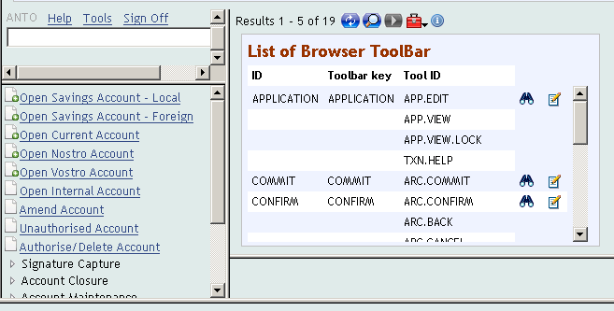
Design the Composite Screen
Create a composite screen as shown in the sample output
Frame for Banner
Frame for enquiry
Blank Frame
Frame for menu
Notes:
Create a composite screen as displayed. Before you create lets try to understand the layout of the composite screen.
The entire browser window is divided into two halves. A column wise split up is used here.
The left frame is to display the banner and the menu.
The third frame is to display an enquiry and a blank frame.
Lets now design the composite screen using the SCREEN.DESIGNER.

Slide 12
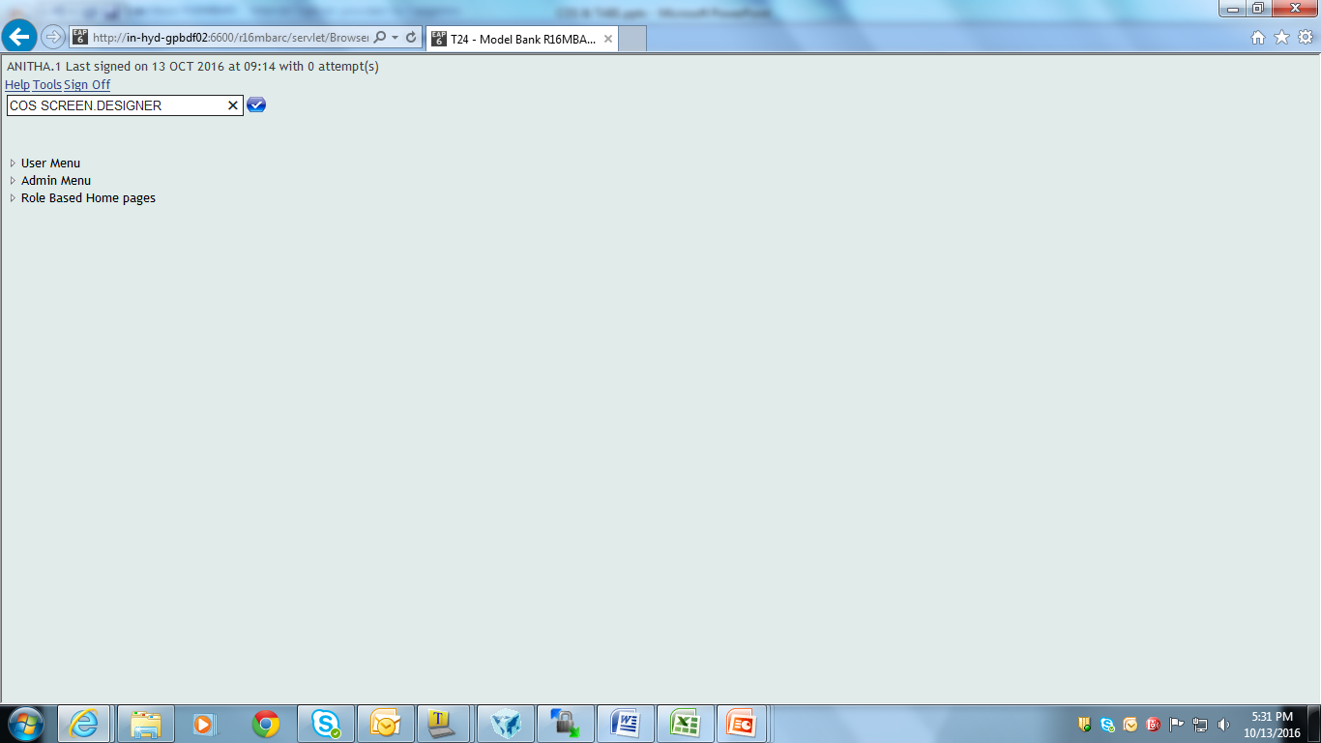
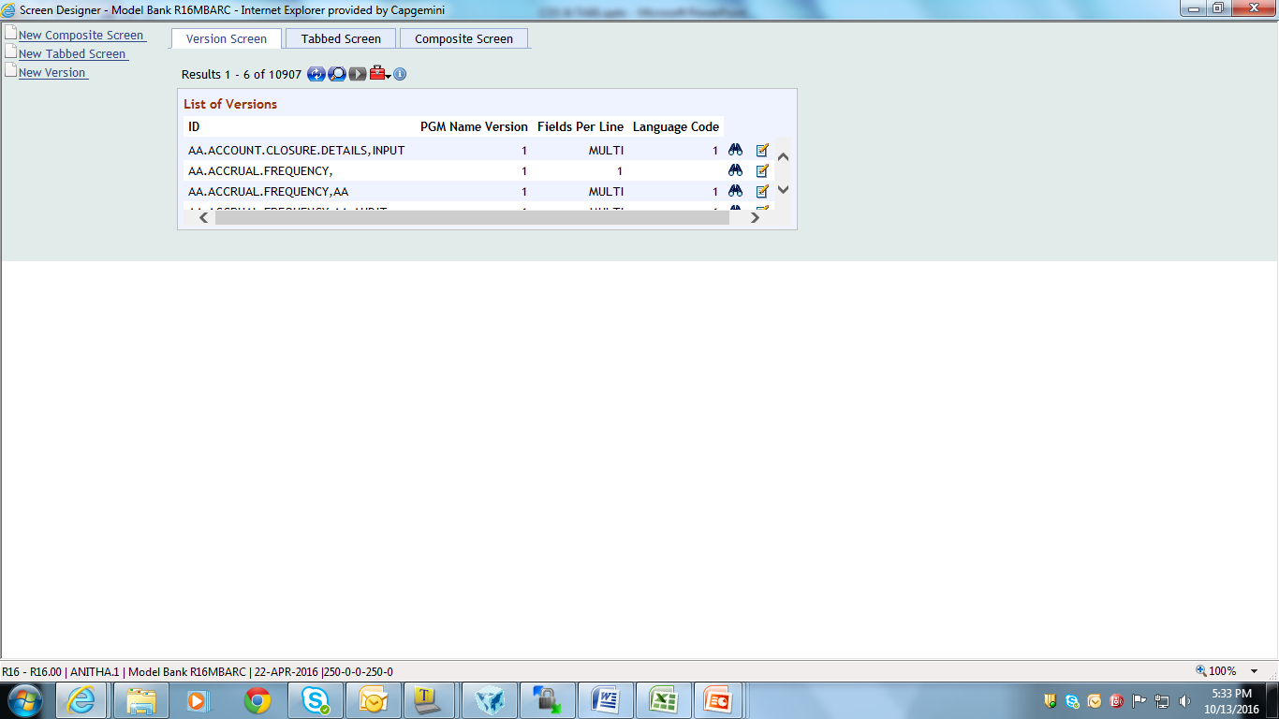
Create the Composite Screen
Notes:
To create a composite screen use the built-in composite screen called SCREEN.DESIGNER. To launch a composite screen use the COS command. Specify COS <space> SCREEN.DESIGNER in the command line. This will launch the composite screen. Use the New Composite Screen link to create one. The id to your composite screen can be any alpha numeric text.

Slide 13
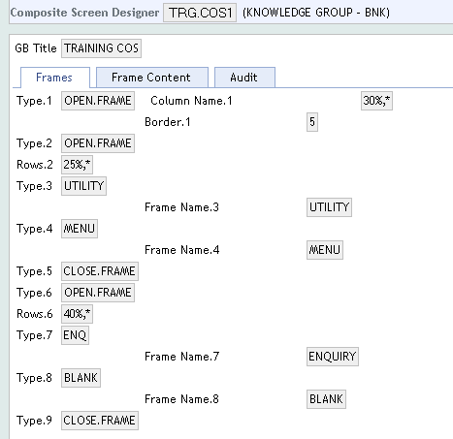
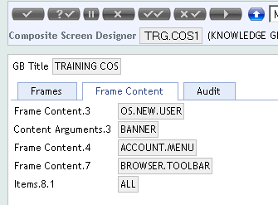
Create the Composite Screen
Notes:
After you specify the title for the composite screen, you need to define the framesets. Your entire browser window should be divided into two halves.
CONTENT.TYPE (Type) – Open a frameset by choosing the OPENFRAME option.
COLS (Column Name) – In the COLS field you can specify the column width for the entire browser screen. Here it is specified as 30%,* stating that left column is of 30% width and the rest 70% is allotted to the right frame.
BORDER.SIZE (Border) – This field is used only when CONTENT.TYPE is set to OPENFRAME. Here you can specify values in the range of 0 – 5.
Your frames can be split further based on the column or row. Left frame should be further divided into two – one to display the banner and the other one for menu. The field CONTENT.TYPE is a multi-value field. You can multi-value and specify the row-wise split up for the frame to display the banner & menu.
How will you display the banner in the top left frame ? You will use a browser routine OS.NEW.USER
CONTENT.TYPE – In the third multi-value of CONTENT.TYPE field the option is specified as UTILITY which lets you to specify browser routines.
NAME (Frame Name)– you may give a user-defined name for your frame here.
CONTENT (Frame Content) - In the field CONTENT specify the routine name.
CONTENT.ARGS (Content Argument)- If CONTENT.TYPE is UTILITY then you will define the arguments for the called utility here. Specify the argument as BANNER.

Slide 14
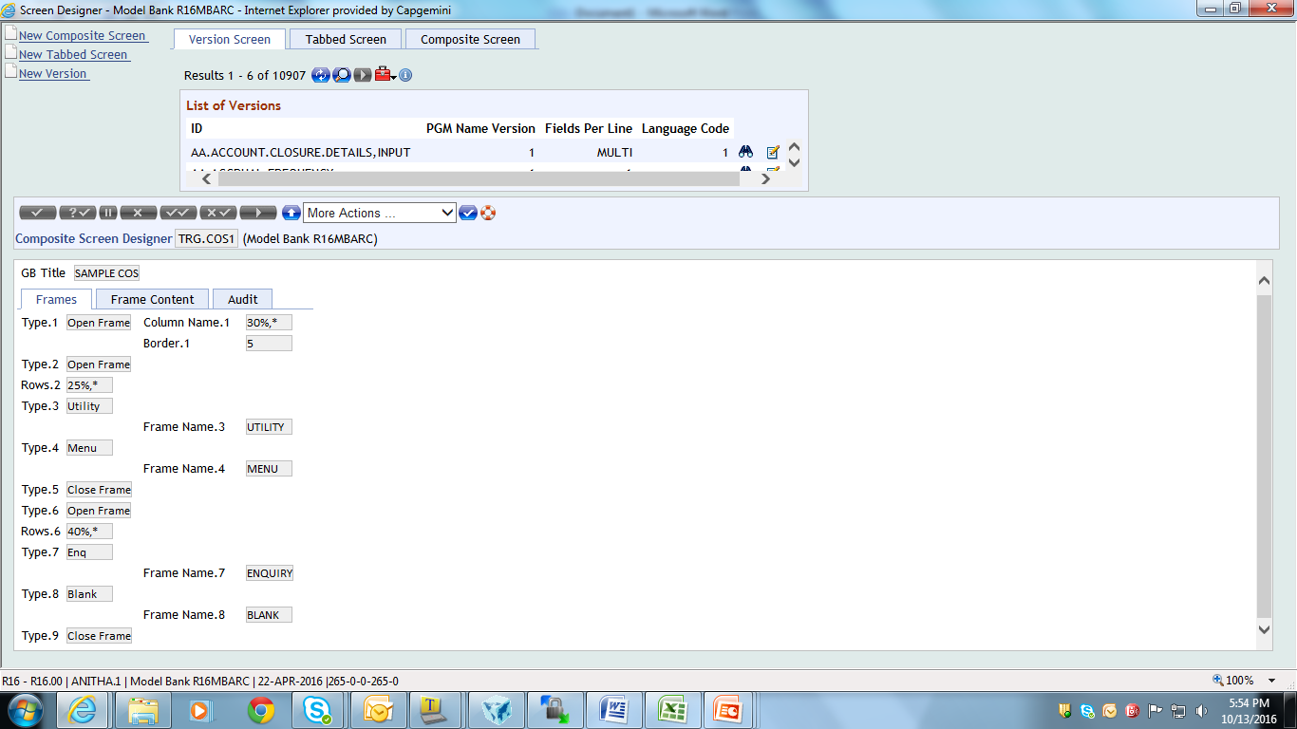
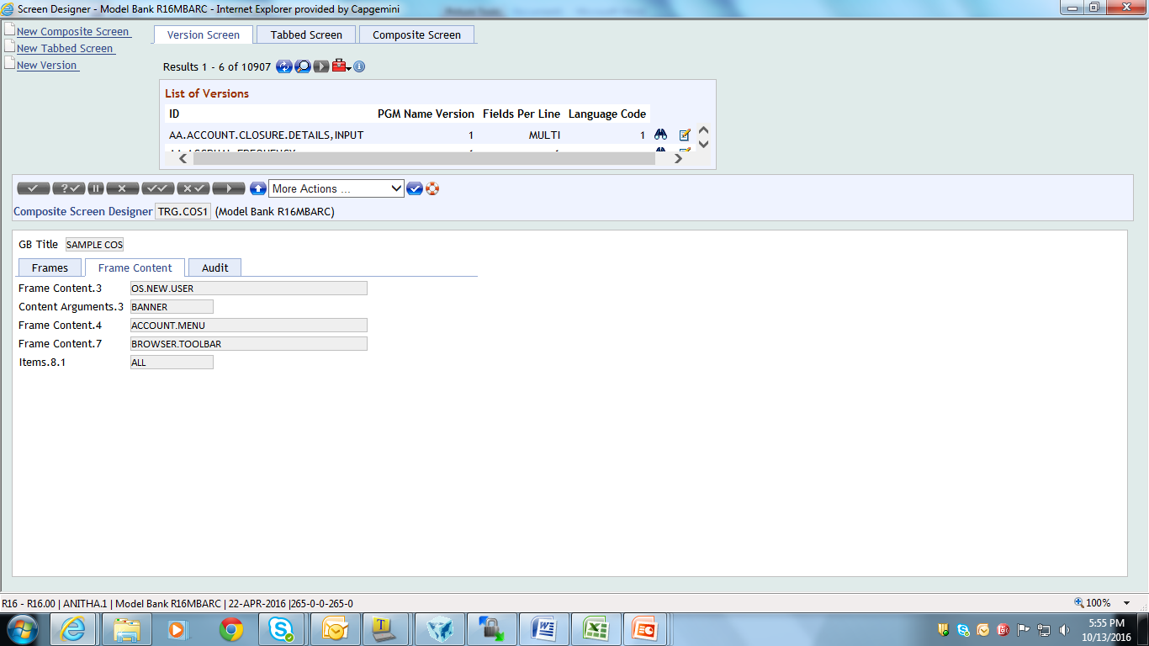
Create the Composite Screen
Notes:
Now give the values to display the menu in the bottom left frame.
CONTENT.TYPE – In the next CONTENT.TYPE multi-value field specify the option as MENU.
CONTENT – Specify the menu that has to invoked. You can attach user-defined menu also.
CONTENT.TYPE - Now that you have completed with the left frame, specify the option as CLOSE.FRAME in the next CONTENT.TYPE multi-value field .
Now lets define the contents of the right frame. Open a new frameset and then define the contents of the right frame of your composite screen.
In the next CONTENT.TYPE field specify the option as OPENFRAME. This frame is split up row-wise. The top frame occupies 40% space.
CONTENT.TYPE – In the next multi-value field of CONTENT.TYPE , specify the option as ENQ as it has to display an enquiry.
CONTENT – Here you will specify the enquiry id.
The bottom right frame should be blank.
CONTENT.TYPE- Specify the option as BLANK here.
ITEMS – Specify as ALL stating that this frame will accept any unassigned requests.
Now close the right frameset after that close the outer most frame-set. After you close all the framesets commit the record and launch the composite screen using the launch option.

Slide 15
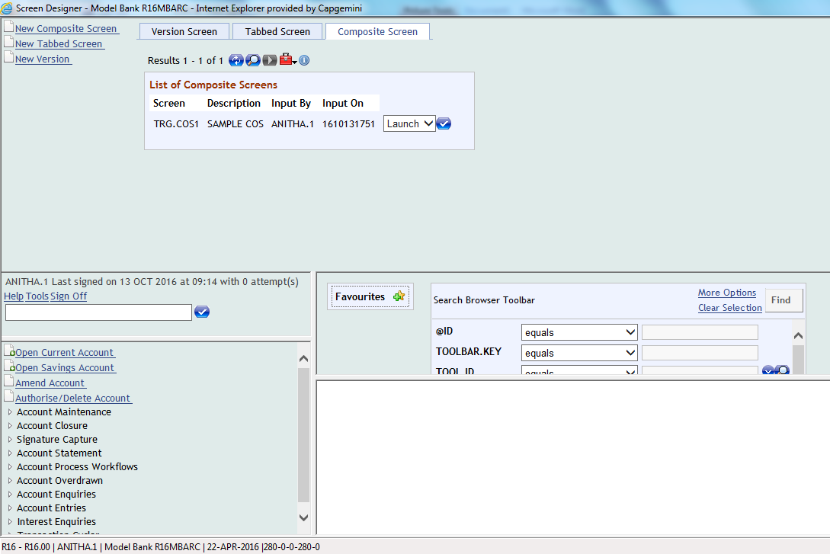
Output
Notes:
Note: Use the launch option to view the composite screen.

Slide 16
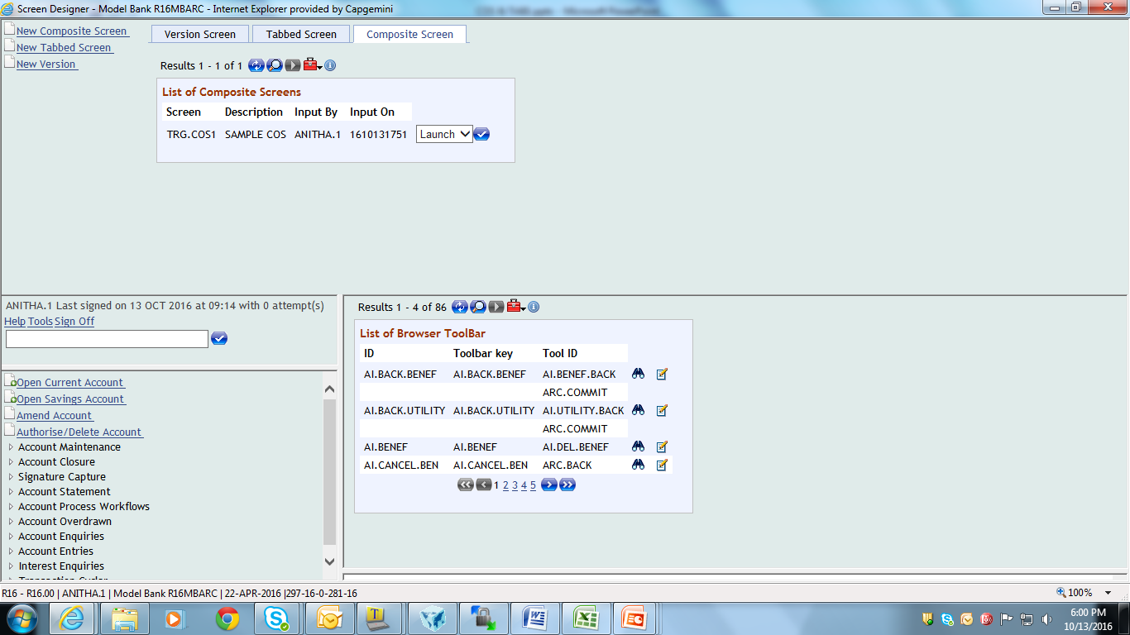
Output
Notes:
Banner and the menu are displayed in the left frame. An enquiry output is launched in the top right frame. Whenever the user clicks on a menu item, the request will be launched in the blank frame as shown here.

Slide 17
Workshop 2
Design a composite screen with the given data
The left frame should display the banner and the menu
The right frame should be split row wise
Top frame should display the html page ‘Temenos Website’
The bottom frame is left blank
Notes:
1.Design a composite screen with the given data
1.1The left frame should display the banner and the menu
1.2 The right frame should be split row wise
1.2.1Top frame should display the html page T24 Editor
1.2.2The bottom frame is left blank

Slide 18
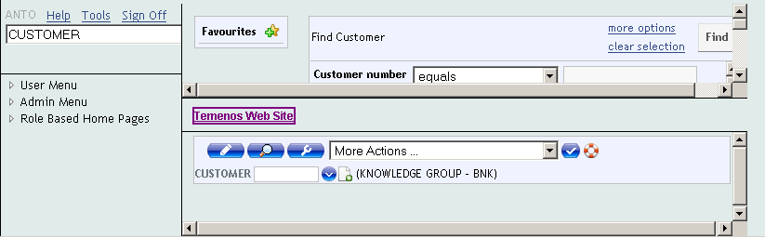
Design the Composite Screen
Create a composite screen as shown in the sample output
Frame for Banner
Enquiry Frame
Frame for URL
Frame for lanuching applications
Frame for menu
Notes:
You will now learn to create a composite screen as shown in the display.
Before you get into the creation process, you need to design your composite screen. Lets look into the contents of each frame.
The browser window is divided into two sections. Consider the first section as left column and the second section as the right column.
The left column is further divided into two frames .The top left frame is to display the banner and bottom left frame is to display the menu.
If you take a look at the right column of your composite screen you can see that it has been split into 3 different frames. This is a row wise spilt up.
The top right frame is to display an enquiry . This enquiry is used to search customer records.
The middle frame displays an internal html page of T24.
The bottom right frame is a blank frame. Whenever the user clicks on the menu all the normal requests should be launched here in this blank frame.

Slide 19
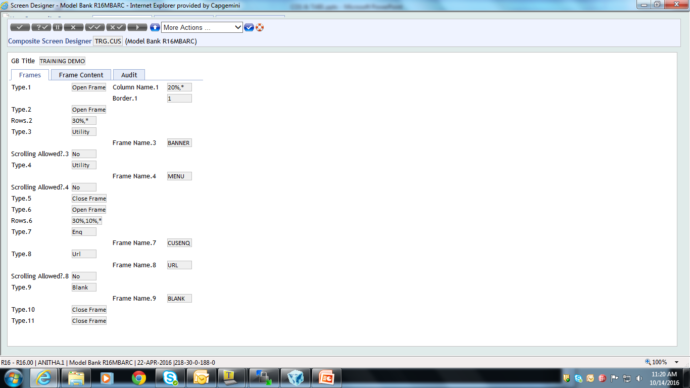
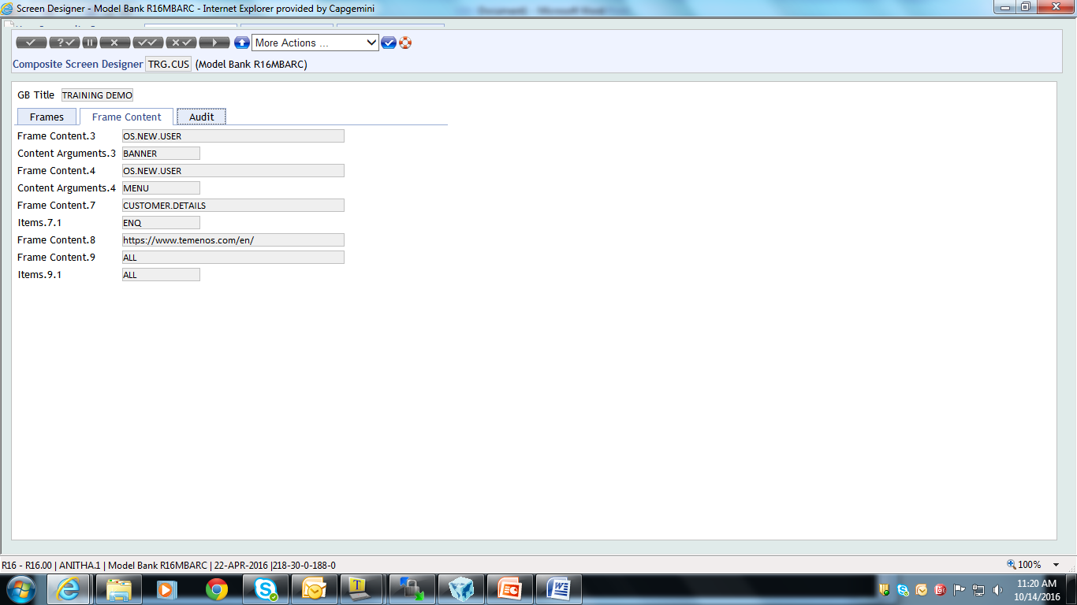
Composite Screen
Notes:
Id to the composite screen can be any alpha numeric text. You will now specify the values for all the required fields. After you specify the title for the composite screen, you need to define the frames.
CONTENT.TYPE – Open a frameset by choosing the OPENFRAME option.
COLS – Divide the entire browser window using the column wise separation
Your left frame should be divided into two – one to display the banner and the other one for menu. You can multi-value and specify the row-wise split up for the frame to display the banner and the menu.
After that you need to open a new frameset for defining the right frame of your composite screen. In the next CONTENT.TYPE specify the option as OPENFRAME. This frame is split up into row-wise.
CONTENT.TYPE - Top frame occupies 30% space. The field CONTENT.TYPE is set to ENQ.
ITEMS – The ITEMS field is used to define what requests should be sent to this frame. Set it ENQ.
CONTENT.TYPE – In the next multi-value field of CONTENT.TYPE , specify the option as URL as it has to display the t24 editor page.
CONTENT – Here you specify the path of the web page.
The bottom right frame is left blank. Close all the frame-sets and launch the composite screen.

Slide 20
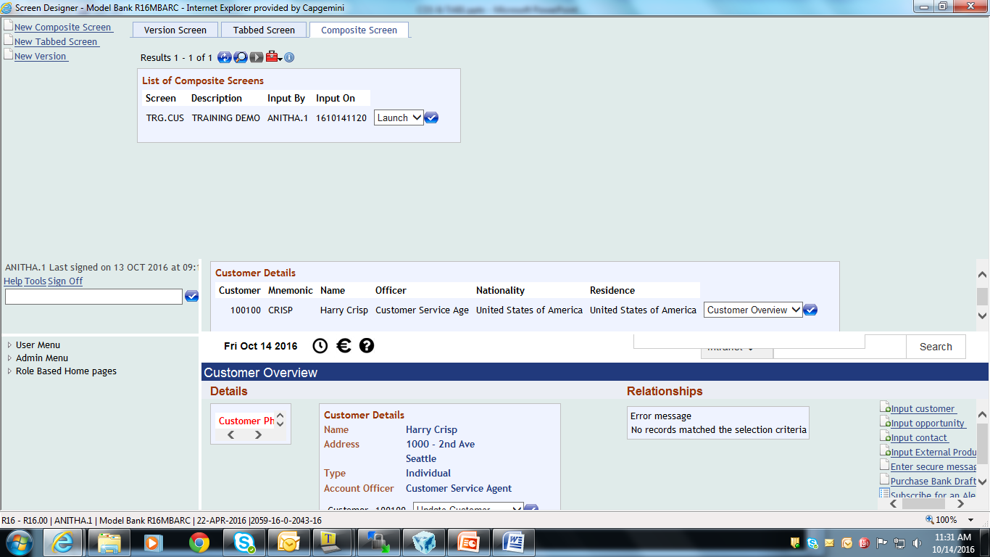
Launch the Composite Screen
Notes:
You are now seeing the designed composite screen.

Slide 21
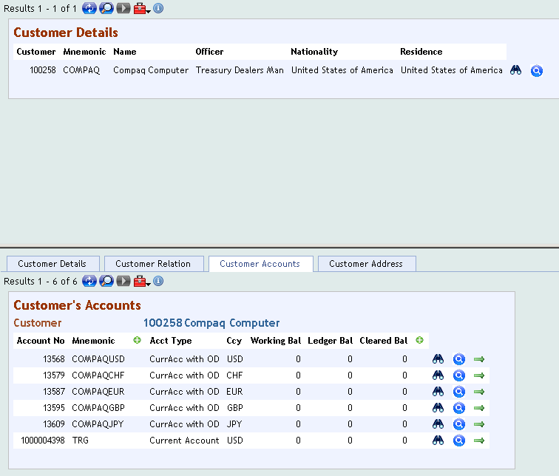
Design the Composite Screen
Notes:
The composite screen shown here is divided into two segments. The top frame launches an enquiry that displays customer details. The other frame launches a tabbed screen. The first frame should be launched only when the user provides a customer number as the run time parameter.

Slide 22
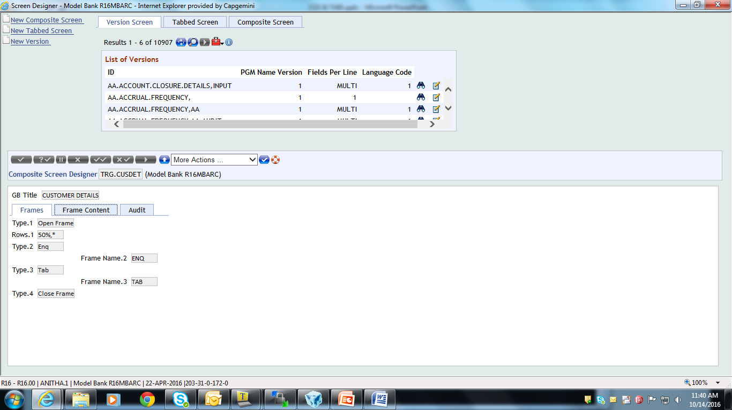
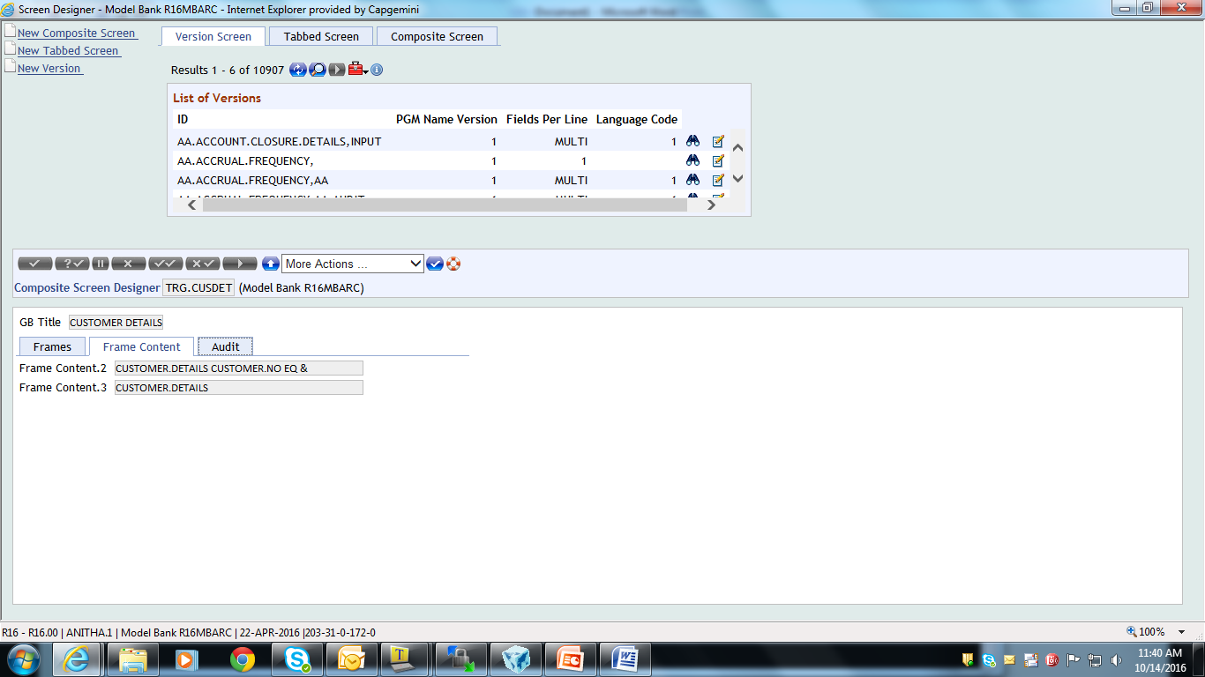
The Composite Screen
Notes:
The id for your composite screen can be any alpha-numeric text. The enquiry to be launched in the top frame is MB.CUSTOMER.DETAILS. The user should always input a run time parameter to this enquiry.
CONTENT – In the CONTENT field you normally specify an enquiry name when CONTENT.TYPE is set to ENQ. In order to pass the run time parameter you need to add three more parameters to the enquiry id. Lets see what are the parameters that you need to attach to the enquiry id,
The first parameter is the FIELD NAME defined as part of the SELECTION.FLDS of the enquiry
The second parameter is the OPERAND
The third parameter is a place holder for the value that you pass
Therefore in the CONTENT field you will specify the enquiry id followed by CUSTOMER.NO EQ & .
For the other frame the CONTENT field holds the id of the tabbed screen.

Slide 23
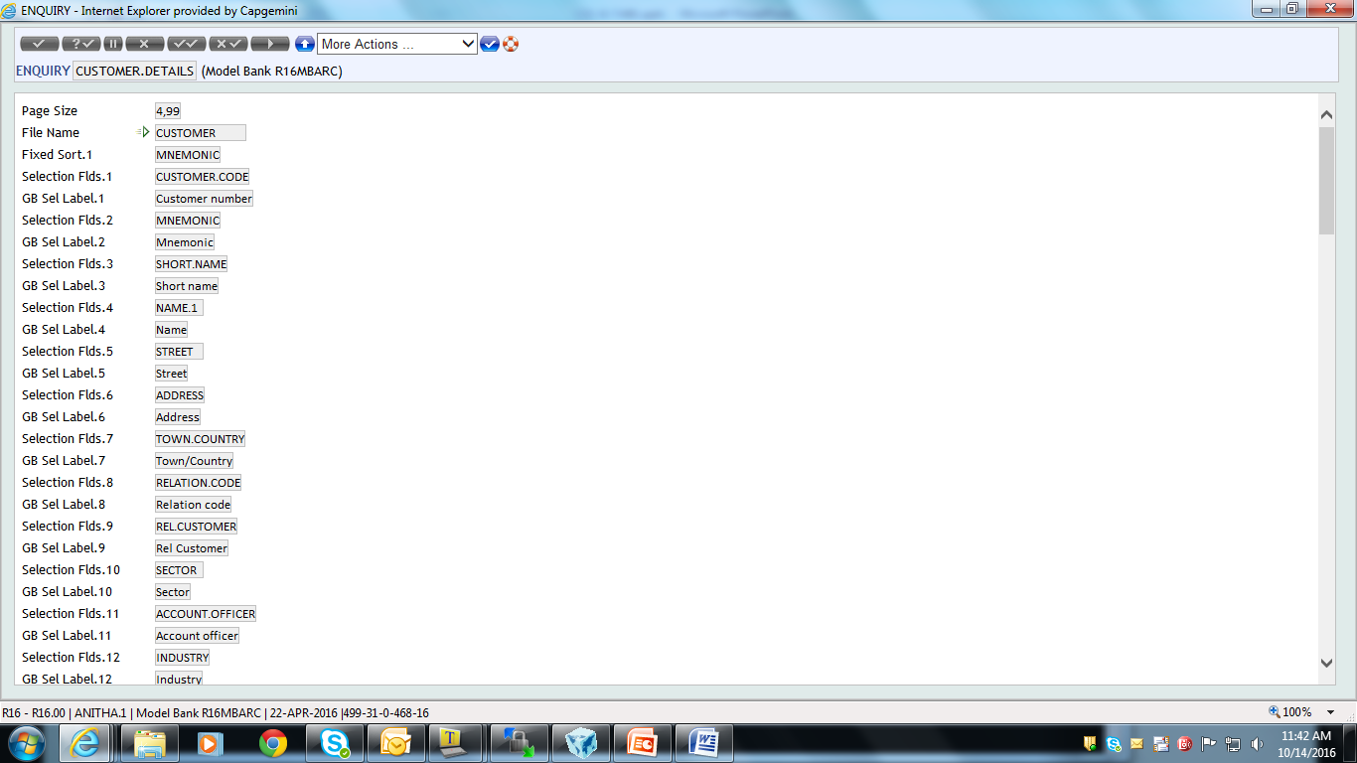
Important Note
Notes:
In the enquiry the field CUSTOMER.NO is defined as part of the SELECTION.FLDS. To pass run time parameters to COS, you should define the field name as part of the SELECTION.FLDS of the enquiry else you will not be able to launch the enquiry using the composite screen.

Slide 24
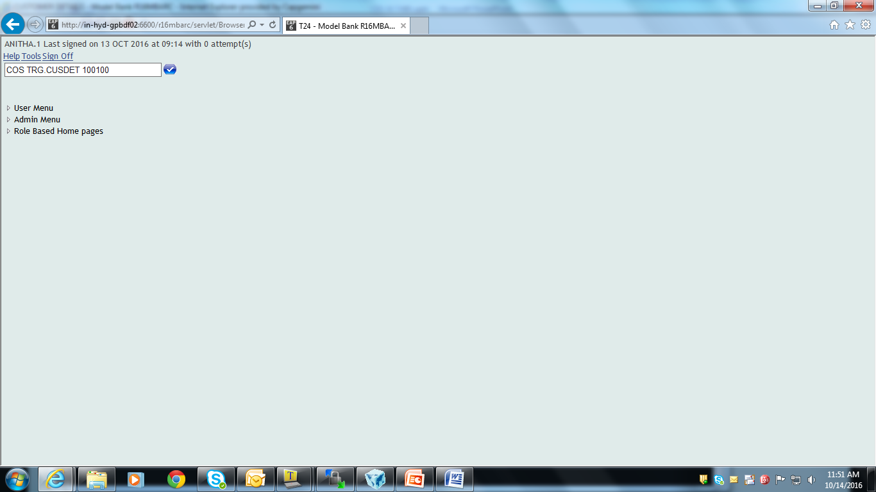
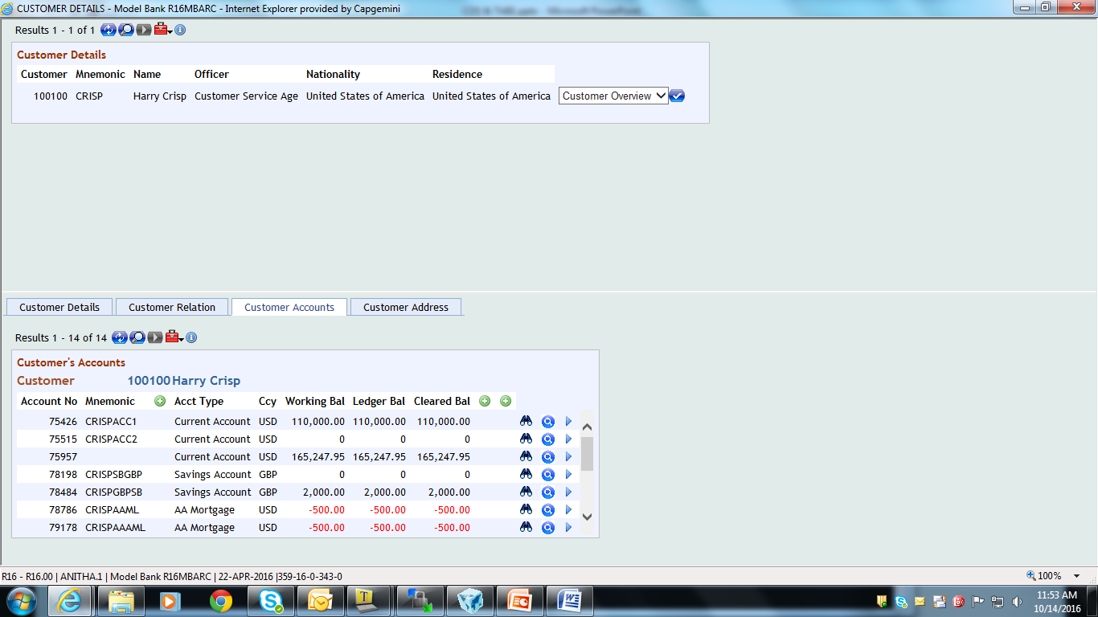
Output
Notes:
Now launch the composite screen from the command line by specifying COS TRG2.MY.CUSTOMERS 100396 , where COS is the command to launch the composite screen , TRG2.MY.CUSTOMERS is the composite screen id and 100258 is the run time parameter passed to the enquiry of the composite screen.
Note : 100258 is the value to the field CUSTOMER.NO

Slide 25
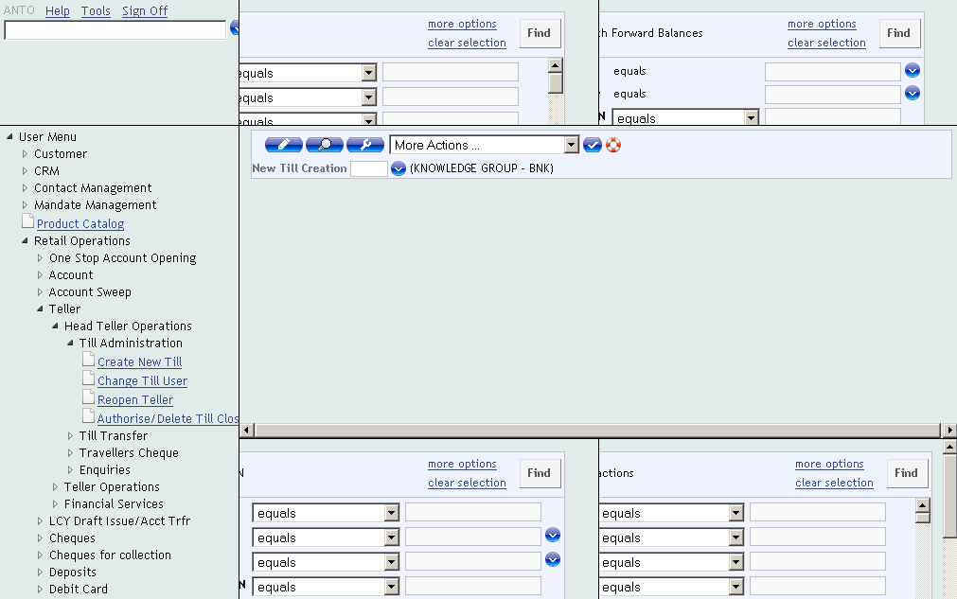
Design the Teller Home Page
Notes:
Have you ever designed role based home pages in T24? Using the role based homepages you can create a customised homepage for a user. The homepages could be designed based on the enquiries and menus that he often uses to perform his day-to-day tasks.
Now you will know how to design a customised homepage for the teller. The components of the teller homepage are as follows:
The banner and the menu are part of the homepage components
The right frame consists of the following components
2.1 Top frame launches two enquiries CR.OPPORTUNITY-PRODUCTS and ACCT.FWD.BALS.AM
2.2 The second frame is left blank
2.3 The bottom frame launches two enquiries namely - TELLER.POSITION and TT.CASH.TXN.AUTH.NAU
A dynamic selection criteria is passed to the enquiry TELLER.POSITION. The selection criteria should fetch records that has TELLER.ID EQ 1510

Slide 26
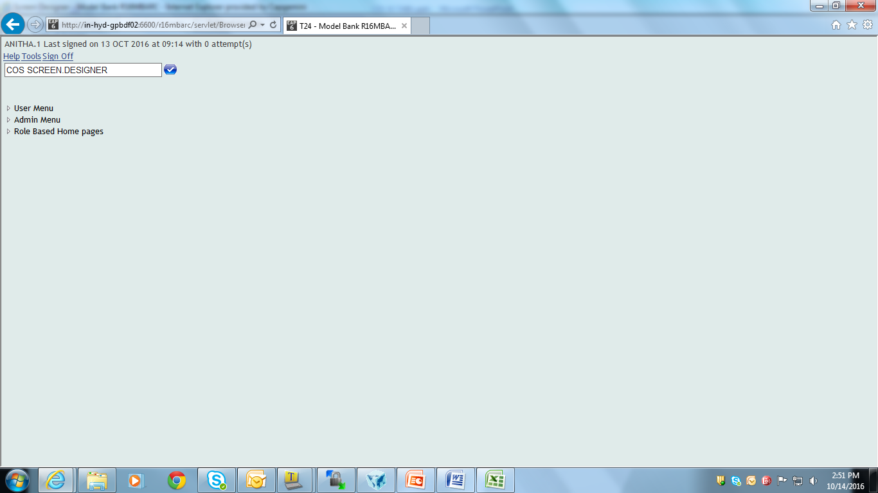
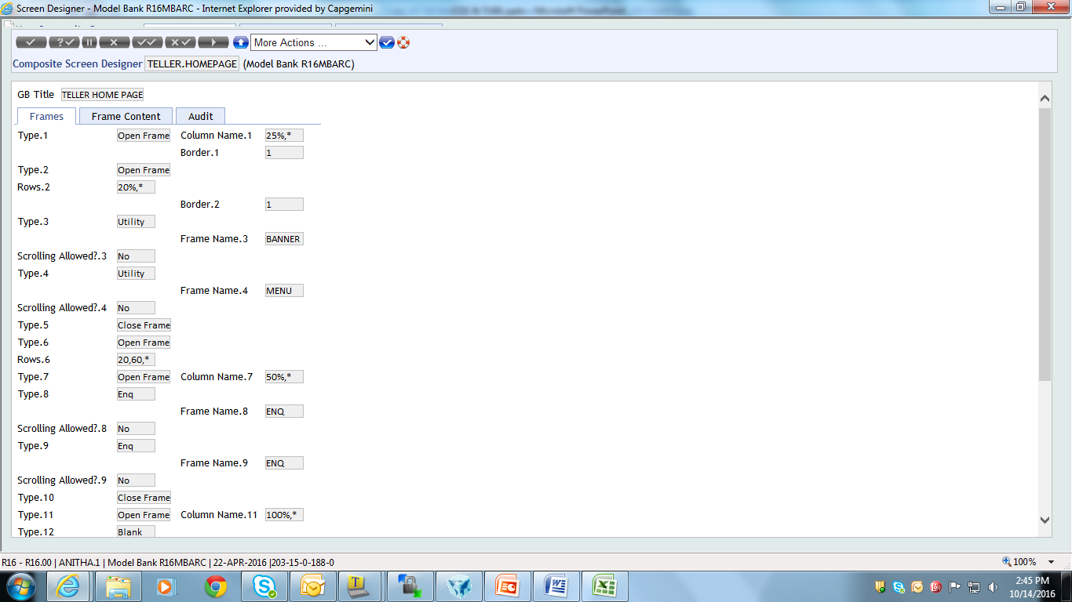
The Composite Screen
Notes:
Lets design the composite screen using the Screen designer. Specify the id and the title for your composite screen. Split the entire browser window into two columns. This is done using the OPENFRAME option of the field TYPE. The left column for the banner and menu occupies 25% of the entire screen. The rest 75% is allotted to the right frame. The left frame is further split row wise to display the banner and the menu.

Slide 27
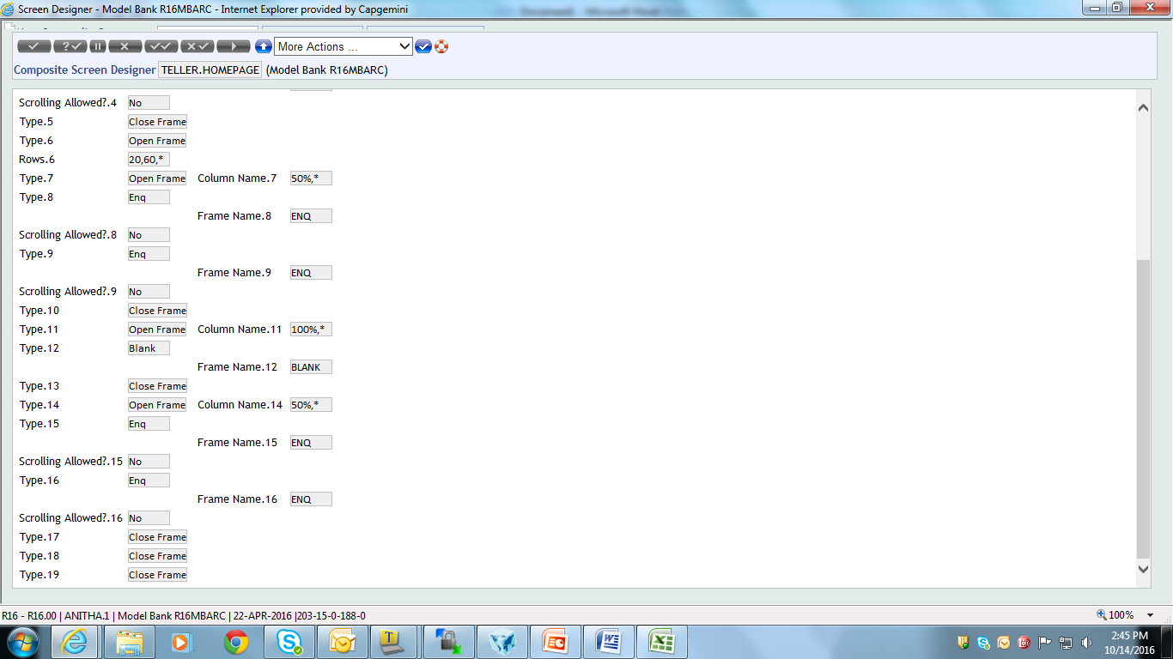
The Composite Screen
Notes:
The right frame is further split row wise. First row occupies 20% space, the second row occupies 60% and the rest is allotted for the bottom frame.
First row – The first row is further split in a column wise manner. Two enquiries are to be launched namely CR.OPPORTUNITY-PRODUCTS and ACCT.FWD.BALS.AM After you specify the enquiry ids close the corresponding frameset.
Second row – The second row is left blank. No enquiry requests are to be launched here.

Slide 28
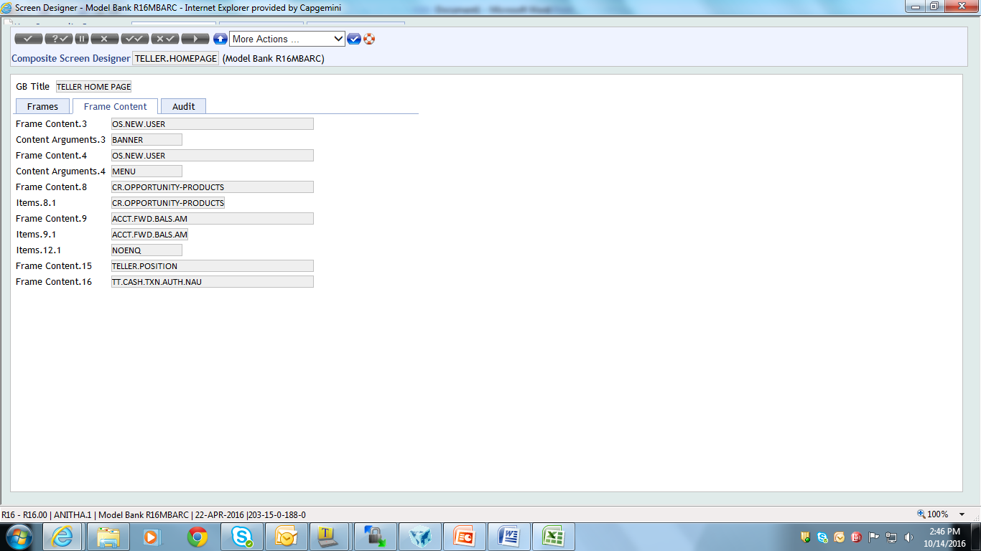
The Composite Screen
Notes:
Last row - The last row occupies 50 % space of the left frame. The last frame is used to launch two enquiries namely TELLER.POSITION and TT.CASH.TXN.AUTH.NAU. Now close the frameset for the last frame and also close the other framesets.

Slide 29
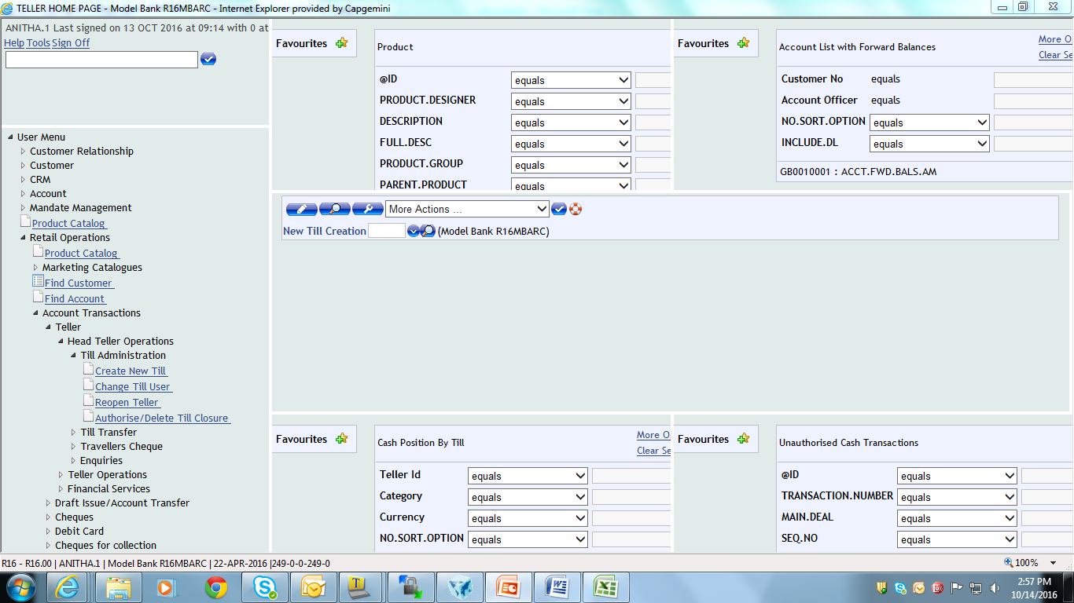
Output
Notes:
The teller homepage is displayed to you here. Banner and the menu are displayed in the left frame. The right frame displays the enquiries and the blank frame.

Slide 30
Tabbed Screens
Tabbed screens provide a better user interface
Tabbed screens are used to group a set of enquiries and versions together
The grouped enquiries and versions are displayed on a single browser window
Each tab will be linked to an enquiry or a version in T24
Notes:
You will now learn about Tabbed screens in T24.
Tabbed screens provide a better user interface
Tabbed screens are used to group a set of enquiries and versions together
The grouped enquiries and versions are displayed on a single browser window
Each tab will be linked to an enquiry or a version in T24

Slide 31
The Need for Tabbed Screens
Tabbed screens are used to group enquiries and versions in a single browser window
Enables easy navigation to the end user
User can access different tasks by the click of a tab
Better user interface to the end user
Notes:
Why do you need tabbed screens ?
You would be familiar with the T24 browser screen. Assume that you want to create an account for a customer and using that account you need to input an FT. In order to accomplish this task you will use two different applications namely, ACCOUNT and FUNDS.TRANSFER. You may open the application screen using the command line. When you do so the application screen will be opened in a different browser window. Again when you invoke the FT application, it opens a new browser window. Is there a way to group these task windows into a single browser screen?
1,2 Tabbed screens are used to group enquiries and versions in a single browser window in T24. This enables easy navigation to the user.
3,4. The user may access these applications by just performing a click action on the corresponding tab. Every time when the user needs to invoke an application he need not use the command line or the default menu in T24. Thereby tabbed screens provide a better user interface to work with.

Slide 32
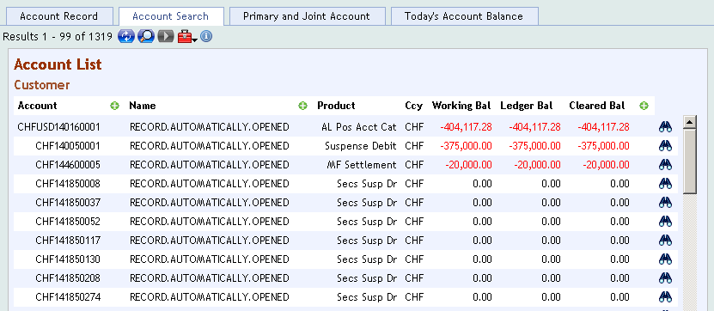
Tabbed Screens in T24
Notes:
You can very well design a similar tabbed screen in T24.
The screen-shot displayed here is a tabbed screen designed in T24 to view the customer details. Here you have four tabs and each tab is linked to an enquiry in T24. You can click on each tab to view the customer related data.

Slide 33
Example
Create a tabbed screen to group different tasks in a single window
The first tab should let you to create account records
The second tab used to search account records
Notes:
This task aims at teaching you how to create a tabbed screen in T24. The requirement for the task is as follows,
Create a tabbed screen to group different tasks in a single window
1.1 The first tab should let you to create account records
1.2 The second tab used to search account records

Slide 34
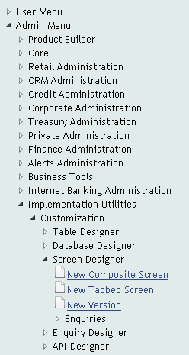
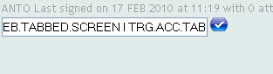
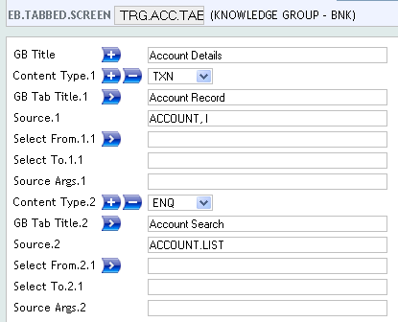
Design the Tabbed Screen
(OR)
Notes:
The screen designer utility found under the admin menu can be used to design the tabbed screen. The application used to create tabbed screen is EB.TABBED.SCREEN. ID to the application can be any alphanumeric text.
The tabbed screen to be designed will have two tabs. Lets have a look into the fields now,
TITLE – Here you will specify a title for your tabbed screen
CONTENT.TYPE – The field CONTENT.TYPE decides the content of your tab. A tab can be linked to an enquiry or it could be a contract screen or it could be a composite screen. The available options in this field are:
ENQ – Option ENQ denotes that the content is an enquiry
TXN – TXN denotes that the content is a contract screen
URL – URL denotes that the item is an URL
COS – COS option denotes that the item is a composite screen ( EG., A valid ID of an EB.COMPOSITE.SCREEN record )
MENU – This options denoted that the content could be a submenu(Eg., A valid ID of a HELPTEXT.MENU record)
The user can use the first tab to create account records. So this is a transaction wherein you can launch a version. So choose the TXN option for the field CONTENT.TYPE

Slide 35
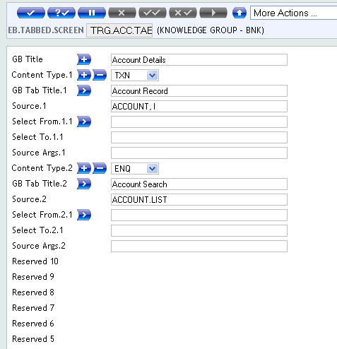
Design the Tabbed Screen
Notes:
A simple title for each tab can also be specified.
TAB.TITLE - Here you will specify the title for each tab in the field TAB.TITLE.
A version should be launched when the user clicks on the first tab. Should the tab be linked to version ?
Remember, each tab in your screen is linked to an enquiry or a version in T24. So where should the link be specified?
SOURCE – In the field SOURCE you either specify the application or the enquiry that is to be invoked for launching the tabbed screen. Therefore in the field SOURCE specify the id of the version.
Multi-value the CONTENT.TYPE field to specify the data for the second tab.
CONTENT.TYPE – Choose the ENQ option here to launch enquiry
SOURCE – In the next multi-value of SOURCE field specify the enquiry name.
Authorise the record created in EB.TABBED.SCREEN

Slide 36
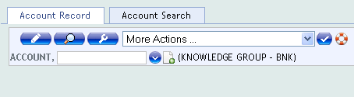
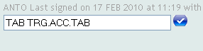
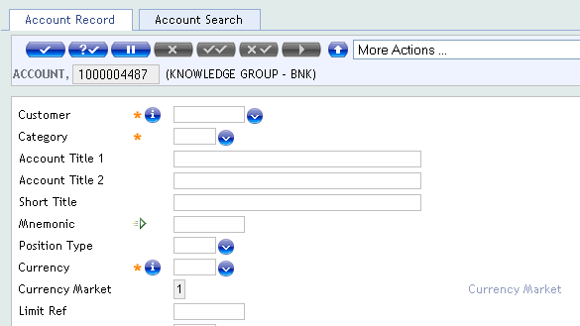
Output
1
2
3
Notes:
Launch the tabbed screen using the command TAB. In the command line specify TAB followed by the id of the tabbed screen
You could see the launched tabbed screen. You can click on the first tab to launch the version
An account record can be created by clicking on the new deal icon.

Slide 37
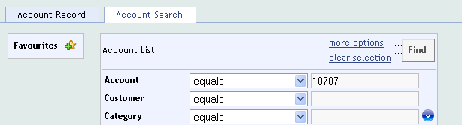
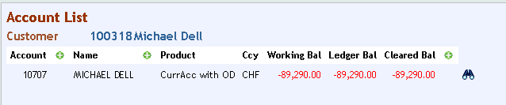
Output
Notes:
The second tab fetches information about account records. You may also specify the selection criteria the first time you launch the enquiry and hence forth the selection criteria will be cached automatically when you launch the tabbed screen . Now isn’t that simpler to create and search account records using the tabbed screen rather than using the command line?

Slide 38
Tabbed Screens
Create a tabbed screen to group various tasks in a single window
The first tab should let you to create account records
The second tab used to search account records
Third tab can be used to fetch information about all accounts of a particular customer
The fourth tab fetches information about account balances
Notes:
This task aims at teaching enquiry mapping in tabbed screens. The requirement for the task is as follows,
Create a tabbed screen to group various tasks in a single window
1.1 The first tab should let you to create account records
1.2 The second tab used to search account records
1.3 Third tab can be used to fetch information about all accounts of a particular customer
1.4 The fourth tab fetches information about account balances

Slide 39
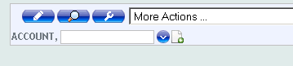
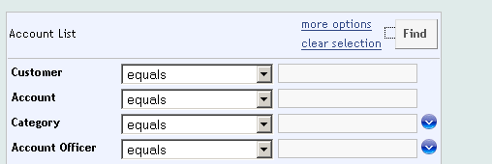
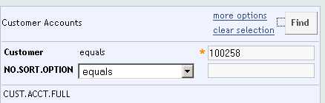
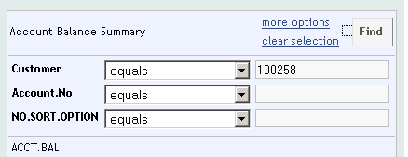
Group the tasks
Notes:
You can see the different tasks that are to be grouped. Create tabbed screens to group these tasks into a single browser window.

Slide 40
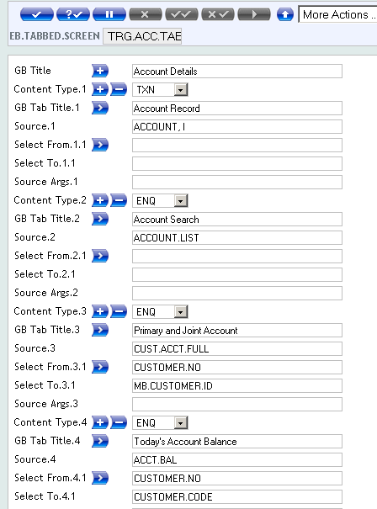
Create the Tabbed Screen
Notes:
The first tab when clicked should launch a version and the second tab should launch an enquiry. So specify the required data in the fields of the first two multi-value sets.
The third tab is also linked to an enquiry.
SOURCE – In the SOURCE field you specify the enquiry that is to be invoked for launching the tabbed screen.
Consider that the user wants to fetch information about a particular customer with id as 100724. He needs to know what are the primary and joint accounts of this customer, also his working balance. The customer id is the selection criteria here. The last three tabs are linked to an enquiry. To all the three enquiries customer id should be passed as the selection criteria. Normally this is done using the selection criteria box. There is another simpler way in tabbed screen to do this.
When you traverse across the tabs, you can pass the selection criteria from one enquiry to another. This is known as Enquiry Mapping . In technical terms, you map your fields to pass the same selection criteria between the enquiries. Isn’t that a simpler way?

Slide 41
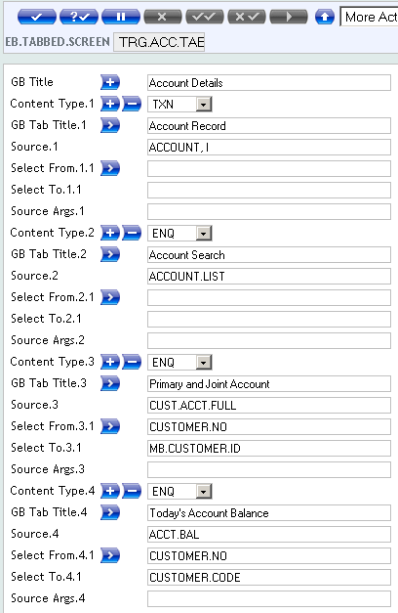
Create the Tabbed Screen
Notes:
Enquiry Mapping is always done with respect to your first enquiry. Now this mapping is done using two fields – SELECT.FROM and SELECT.TO
SELECT.FROM – In this field specify the field name based on which you want to retrieve data. The value of CUSTOMER.NO is passed from the first enquiry to the other enquiry.
Important Note : The field name should be part of your selection fields of the first enquiry.
SELECT.TO – In the field SELECT.TO specify the destination field to which you map the data. The field MB.CUSTOMER.ID belongs to the current enquiry. Therefore you map a field from the first enquiry to a field in the next enquiry.
SELECT.FROM is multi-value field so you can map multiple fields among the enquiries.
The last tab is used to fetch the working balance information. In the last multi-value set, the value from CUSTOMER.NO field is mapped to the field CUSTOMER.CODE in the current enquiry. The value of CUSTOMER.NO is retrieved from the parent enquiry.

Slide 42
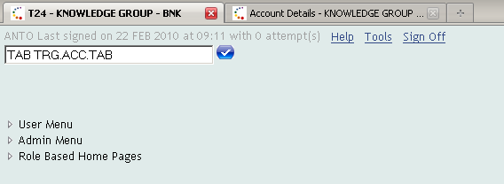
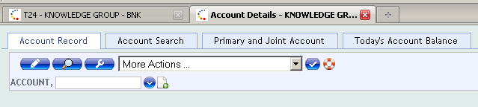
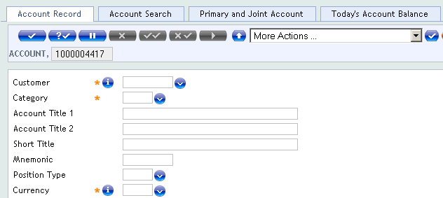
Output
Notes:
After creating the tabbed screen, execute it from the command line using the TAB command. You can see the first tab using which you can create accounts.

Slide 43


Output
Notes:
The second tab executes an enquiry to fetch account details. Specify the CUSTOMER.NO in the selection criteria box. The user executes the enquiry to view all the accounts that belong to the customer.

Slide 44

Output
Notes:
You can click on the third tab to view all the primary and joint accounts of the same customer. The customer id is automatically populated by the field in the first enquiry.

Slide 45

Output
Notes:
The same customer id is also passed to the last enquiry of the tabbed screen. Here you see the working balance of the various accounts that belong to the same customer.

Slide 46


Output – passing runtime parameter
Notes:
The second component of the tabbed screen is an enquiry that fetches the account details. Lets say that the user wants to retrieve account details of a specific customer. You very well knew that this can be done using the dynamic selection criteria box of the enquiry.
Now in tabbed screens the runtime selection criteria can be passed from the command line also. Here the user wishes to pass the runtime parameter to the second tab of the tabbed screen . When the user launches the tab from the command line he has to specify the tabbed screen name along with the tab number and the field name with the value. For example here it is specified as ‘TAB TRG.ACC.TAB 2 CUSTOMER EQ 100258’ where TRG.ACC.TAB is the tabbed screen id. The number 2 specifies that you are invoking the second tab. Finally the field name and its value are passed as CUSTOMER EQ 100258.

Slide 47
Output – passing runtime parameter
Notes:
The second component of the tabbed screen is an enquiry that fetches the account details. Lets say that the user wants to retrieve account details of a specific customer. You very well knew that this can be done using the dynamic selection criteria box of the enquiry.
Now in tabbed screens the runtime selection criteria can be passed from the command line also. Here the user wishes to pass the runtime parameter to the second tab of the tabbed screen . When the user launches the tab from the command line he has to specify the tabbed screen name along with the tab number and the field name with the value. For example here it is specified as ‘TAB TRG.ACC.TAB 2 CUSTOMER EQ 100258’ where TRG.ACC.TAB is the tabbed screen id. The number 2 specifies that you are invoking the second tab. Finally the field name and its value are passed as CUSTOMER EQ 100258.

Slide 48


www.capgemini.com/financialservices

